Slide 1

Pneumonia Detection
Part 1. Basic Medical Knowledge

Slide 2

Illustration of the chest anatomy
There is a mass of tissue, skin, muscles, fat, bones, heart, and big blood vessels.
But it is not useful for Pneumonia Detection.

Slide 3
Chest Radiographs Basics
Black = Air
White = Bone
Grey = Tissue or Fluid

Slide 4
What is Opacity?
Opacity refers to any area that preferentially attenuates the X-ray beam therefore appears more opaque than the surrounding area.
Or
Any area in the chest radiograph that is more white than it should be.

Slide 5
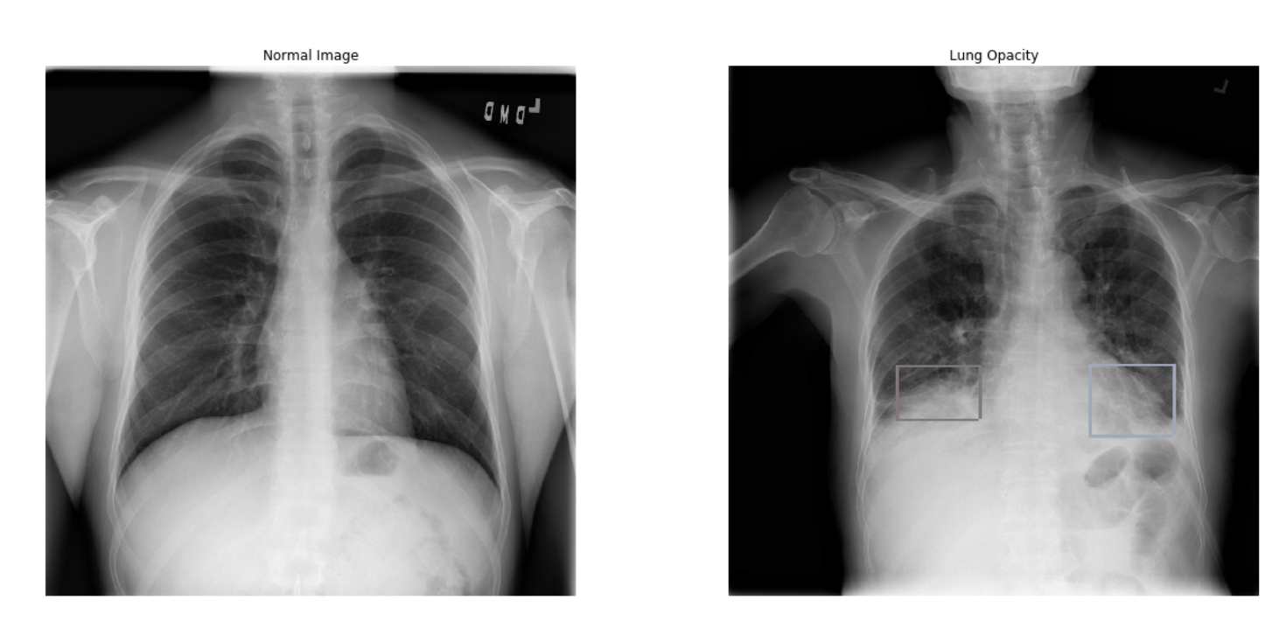
Normal vs Lung Opacity
Opacity refers to any area that preferentially attenuates the X-ray beam therefore appears more opaque than the surrounding area.
Or
Any area in the chest radiograph that is more white than it should be.

Slide 6
Normal vs Lung Opacity
Usually, The lungs are full of air.
However, when someone has pneumonia, the air in the lungs is replaced by other material such as fluids, bacteria, immune system cells, etc.

Slide 7
Some considerations when building our model
Lung Opacities are not homogenous and they do not have a clear center or clear boundaries.
So that We can’t properly segment opacities out of the entire picture.
However, we can segment the lungs properly and filter out the rest of the image. We can create a clean image of the lungs for our neural network to process.
We can refer to implementation of U-Net and Lesson2 : Lung X-Rays Semantic Segmentation on Google Colab.

Slide 8
Special Case 1 – Lung Nodules and Masses
This patient has a Target value of 0, which means he does not have a diagnosis of pneumonia.
But there are obvious opacities in this image, so what’s going on?

Slide 9
Lung Nodules and Masses
There are different kinds of opacities. Some are related to Pneumonia and some are not.
Opacities in Sample Patient 3 are Lung Nodules and Masses.
Unfortunately, it seems like Patient 3 he has multiple lung tumors, probably from invasive cancer.

Slide 10
What makes Pneumonia unique?

Slide 11
Lung Nodules and Masses
The main difference in the types of opacities between these two patients is the borders and the shape of the opacity.
Patient 3 has multiple round and clearly defined opacities.

Slide 12
Lung Opacity
Patient 2 has this poorly defined haziness which obscures the margins of the lungs and heart.
This haziness is termed consolidation(폐경화)

Slide 13
Pneumonia
Usually, there are airs in Alveoli.
But if someone got Pneumonia,
Alveoli filled with fluid.

Slide 14
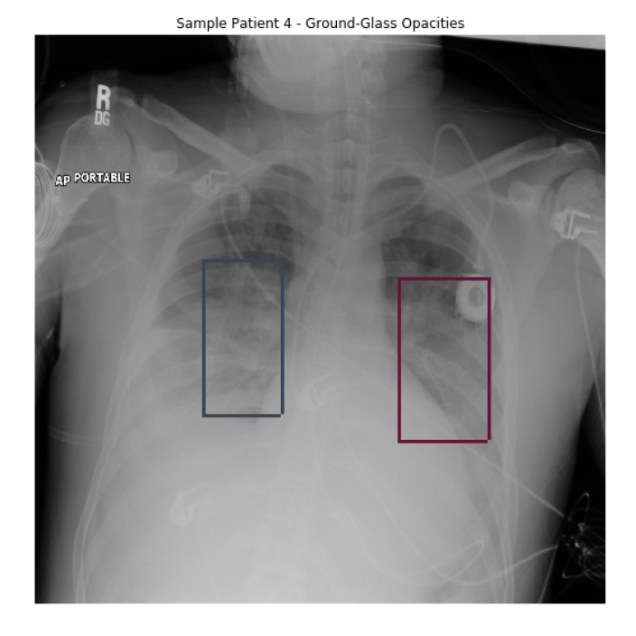
Ground Glass Opacities(GGO)
We can see that the lungs are whiter than they should be, but we can see most of the border of the lungs and heart.
GGO is less opaque than Consolidation.

Slide 15
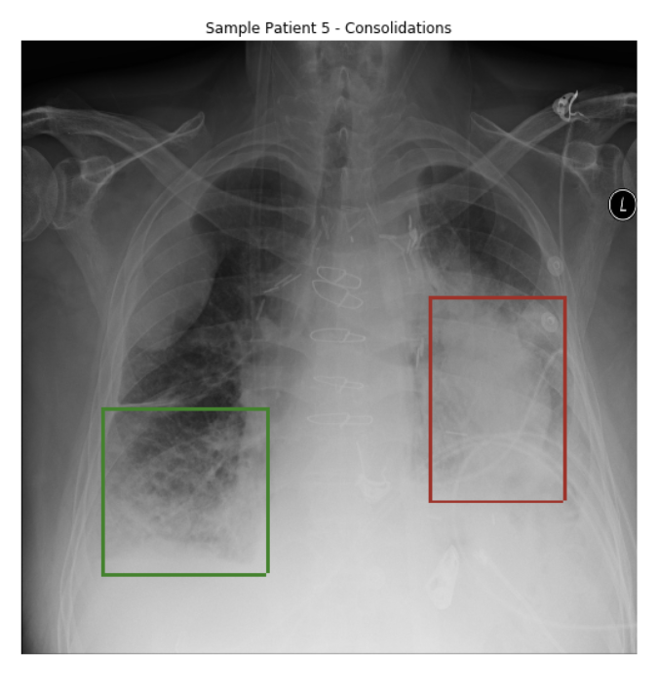
Consolidations
There are fuzzy areas in the lungs and the borders of the lungs and heart cannot be seen.
We can refer to this link

Slide 16
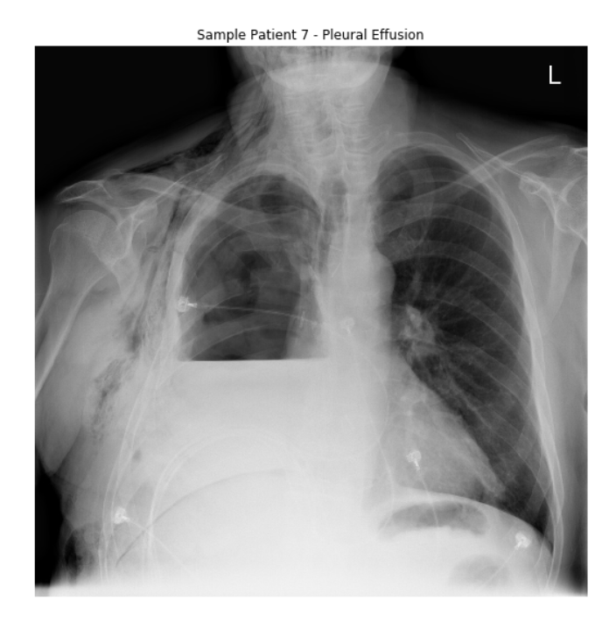
Special Case 2 – Pleural Effusion
It seems like Consolidation.
However, it is Pleural Effusion. It is caused by an accumulation of fluid in the chest outside of the lung.
It’s not related to Pneumonia

Slide 17
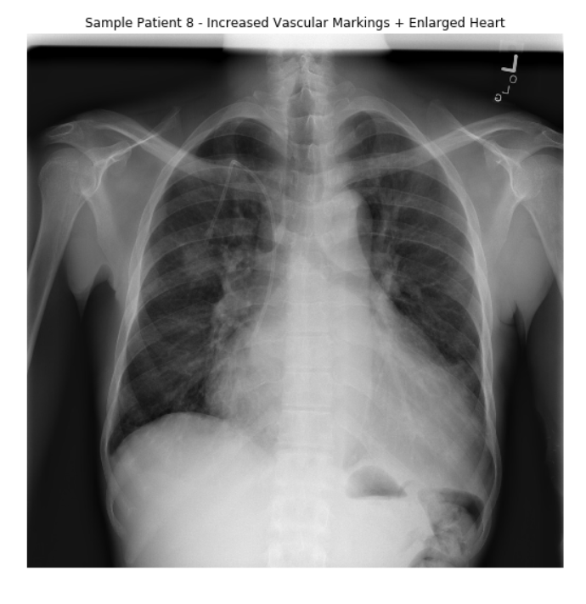
Special Case 3 – Increased Vascular Marking
The heart takes more space than it should be.
The heart should not be bigger than half of the chest cavity.
Also, there is an increased number and intensity of the lines coming out of the heart.
These are pulmonary blood vessels.

Slide 18
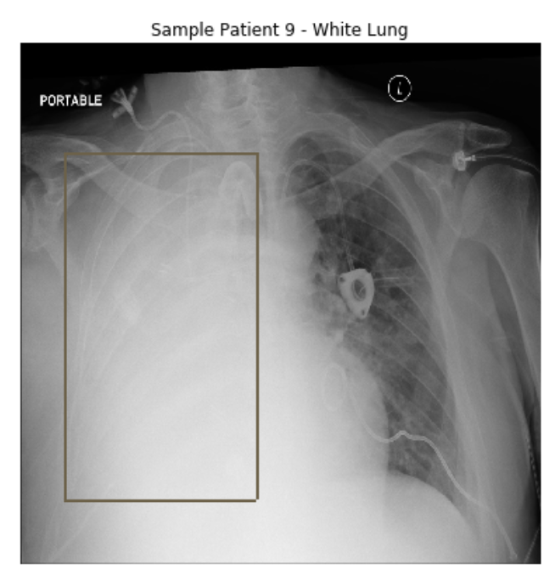
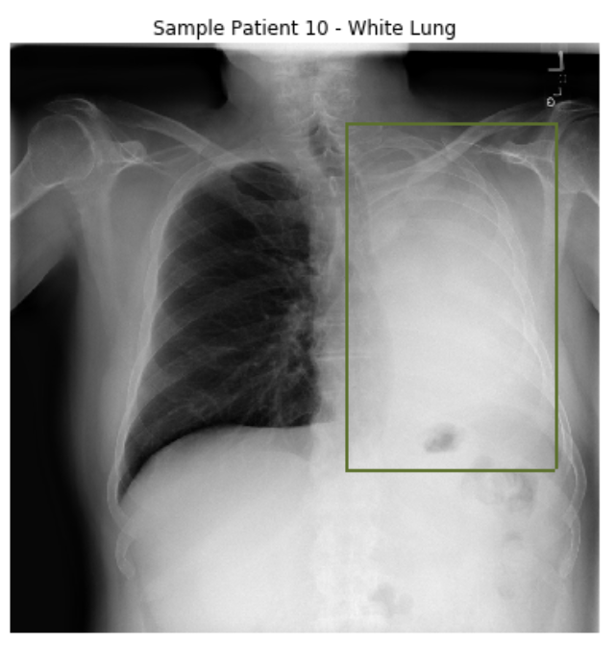
Special Case 4 – White Lung

Slide 19
Special Case 4 – White Lung
There are three cases.
The lung was removed in a surgery called pneumonectomy
The lung is filled with fluid from pneumonia
The lung is there but it is surrounded by fluids inside the chest cavity(Pleural effusion)
Since this competition is about pneumonia, and these patients have a “Target” value of 1, the cause for their big opacity is most probably pneumonia.

Slide 20
Special Case 4 – White Lung
There are three cases.
The lung was removed in a surgery called pneumonectomy
The lung is filled with fluid from pneumonia
The lung is there but it is surrounded by fluids inside the chest cavity(Pleural effusion)
Since this competition is about pneumonia, and these patients have a “Target” value of 1, the cause for their big opacity is most probably pneumonia.

Slide 21
Pneumonia Detection
Part 2. Model Implementation

Slide 22

First Try : YOLOv3 Model with DarkNet-53
At First, since we don’t have enough computing power for learning.
we tried YOLO model.
YOLO has faster execution time than other models such as R-CNN or Mask R-CNN.
We used 106 Layer model with 15300 iteration.
And we used Batch Normalization for prevent overfitting problem.
We got 0.141 score. And Ranked 300 / 1000. TOP 30%.

Slide 23
First Try : YOLOv3 Model with DarkNet-53
Advantage :
We can get high score with more less time and computing power.
YOLO is more easy to use than other algorithm.
Drawback :
There is Limitation on score. ( It’s hard to get more high scores then 0.155 )

Slide 24
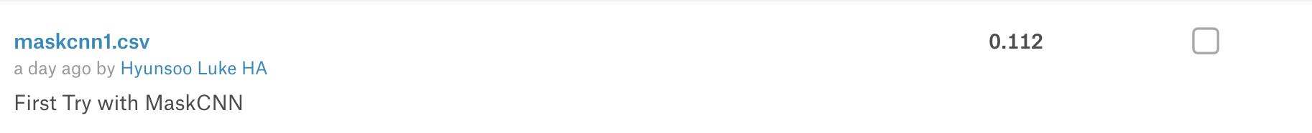
Second Try : Mask RCNN with epoch 6.
We studied many model such as YOLO, SSD, RCNN in this week.
And our conclusion was “Mask-RCNN is most proper model for this project”.
Because this competition’s goal is find Lung Opacities as a bound box.
And Mask-RCNN model use bound boxes for classification.
However, Mask RCNN needs computing power a lot, so we should change our epoch more less (just 6 epoch)
As a result, We got 0.112 score. It was worse than YOLOv3.

Slide 25
Second Try : Mask RCNN with epoch 6.
Advantage :
We can find lung opacities by bound boxes.
We can get more accurate result.
Drawback :
This is more complex model so that we need more time and computing power to use this model.
Hard to analysis source code since it is very complex.

Slide 26
Third Try : Mask RCNN with epoch 26.
We thought Second Try’s low score was caused by our hyperparameter setting.
6 epoch was too small to get accurate result.
So we changed our epoch from 6 to 26.
And we used Kaggle kernel cloud all day long for learning.
Finally We got 0.155 score. With ranked 160/ 1100. TOP 15%

Slide 27
The things we have to do
hyperparameter optimization.
Improve our model by adding more layers or changing FC layer’s classification algorithm.
Find more accurate and efficient epoch value.
Find more accurate and efficient step for epoch value.
Preventing Overfitting problem for stage2
Our goals : Get Bronze medal ( TOP 10% )

